Slide 1
Chapter 9
Chapter 9
Broadband Network Management:
ATM Networks
Network Management: Principles and Practice
© Mani Subramanian 2000
9-1

Slide 2
Chapter 9
Broadband Services
Broadband Integrated Services Digital Network
(BISDN)
  Voice, video, and data services
  Transport protocol and medium
(Basic) Integrated Services Digital Network (ISDN)
  2B + D
WAN
  ATM Cell-based Technology
  SONET / OC-n (n x 51.84 Mbps)
  SDH / STS
LAN
  ATM LAN Emulation
Access Technology
  Cable modem / HFC
  DSL
  Wireless
  Notes
Network Management: Principles and Practice
© Mani Subramanian 2000
9-2

Slide 3
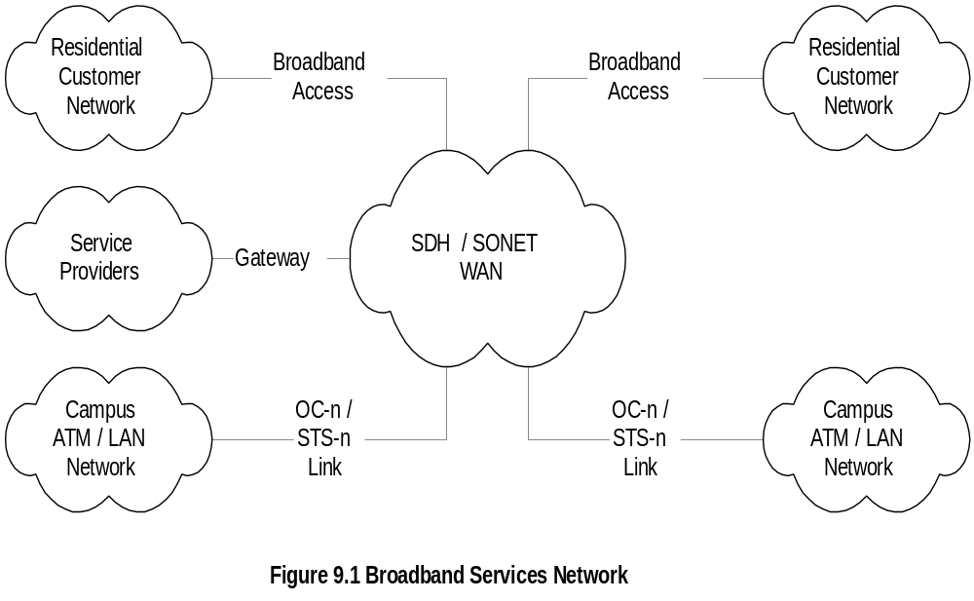
Chapter 9
Broadband Services Network
  Notes
SDH / SONET is WAN
Access to corporate and residence / SOHO
  OC-n used to access institutions
  HFC and DSL used for residence
  Wireless technology in early stage
Network Management: Principles and Practice
© Mani Subramanian 2000
9-3

Slide 4
Chapter 9
ATM Technology
ATM technology based on:
  VP / VC
  Fixed packet size or cell
  Small packet size (53 bytes)
  Statistical multiplexing
  Integrated services
  Notes
Packets in a session take the same path in VP/VC
After initial set up, latency is reduced
SDH/ SONET in WAN uses 155.52 Mbps as basic
data rate and is universal (in contrast to T1 and E1)
Transmission medium primarily optical fiber
ATM used in LAN for high speed emulating
Ethernet LAN
Network Management: Principles and Practice
© Mani Subramanian 2000
9-4

Slide 5
Chapter 9
ATM LAN Emulation (LANE)
Difference between ATM and Ethernet
  ATM is connection-oriented
  ATM makes one-to-one connection
  ATM 20-byte addressing scheme
  different from 6-byte Ethernet MAC address
LANE emulates services of a traditional LAN
  Notes
Network Management: Principles and Practice
© Mani Subramanian 2000
9-5

Slide 6
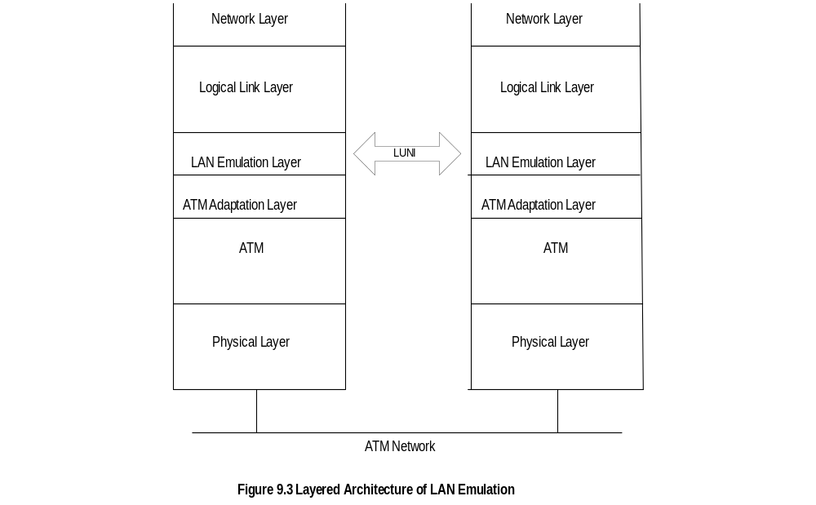
Chapter 9
LANE Protocol Architecture
  Notes
LAN emulation layer inserted between LLC and AAL
LLC and above represent typical TCP/IP Internet
environment
ATM Forum specifications address LANE
User-Network interface (LUNI)
ATM workstation called LAN emulation client (LEC)
Network Management: Principles and Practice
© Mani Subramanian 2000
9-6

Slide 7
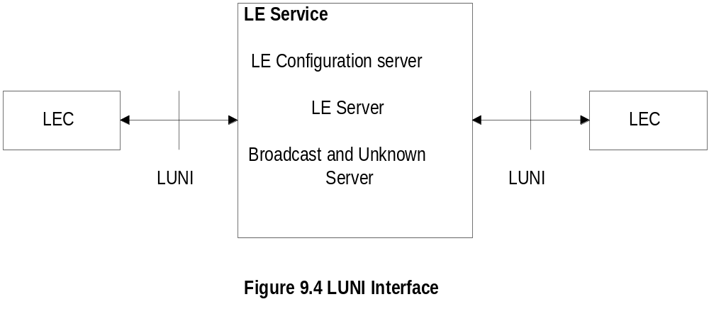
Chapter 9
LUNI Interface
  Notes
LAN emulation services:
  LE configuration server (LECS) assigns LECs
  to emulated LANs
  LE server (LES) performs control and coordination
  functions for ELANs - registration, address
  resolution, route descriptors, etc.
  Broadcast and unknown server (BUS) handles
  broadcast and multicast packets, and unknown
  address resolution
Network Management: Principles and Practice
© Mani Subramanian 2000
9-7

Slide 8
Chapter 9
LUNI Functions
Initialization
  Obtaining ATM addresses of LESs
  LEC joining a LANE
  Ability to handle address resolution requests
Registration
  LES appraised of LEC-to-MAC address
  LES appraised of source-routing parameters
  for source-routing bridge
Address resolution
  LEC-MAC address resolution
Transport
  Data encapsulated with ATM frame AAL-5
  at LE source and decapsulated at destination
  Notes
Network Management: Principles and Practice
© Mani Subramanian 2000
9-8

Slide 9
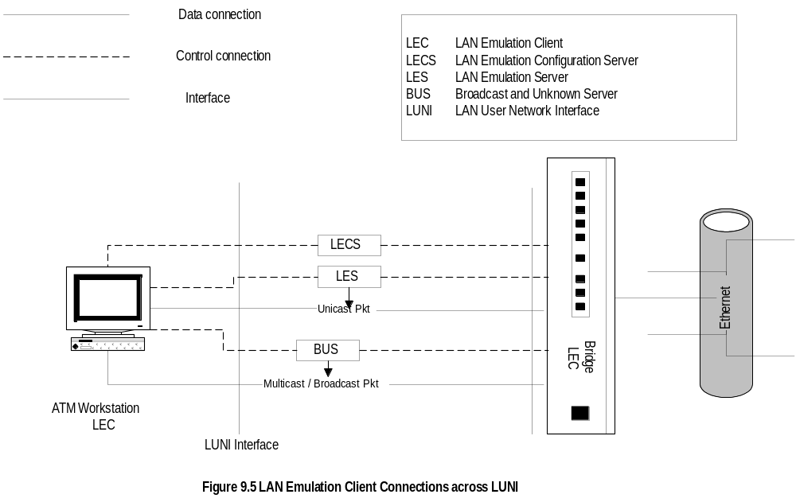
Chapter 9
ATM LAN Emulation
  Notes
ATM workstation communicates with Ethernet
workstation using LE services
ATM workstation behaves as an LE client and
interfaces via LUNI
Ethernet workstation interfaces via a bridge acting
as LEC
LECS, LES, and BUS could be stand-alone devices
or part of ATM switch
Control connections established before data transfer
Network Management: Principles and Practice
© Mani Subramanian 2000
9-9

Slide 10
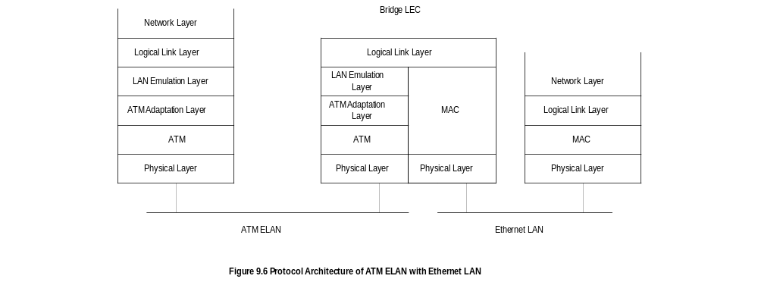
Chapter 9
LANE Protocol Architecture
  Notes
Network Management: Principles and Practice
© Mani Subramanian 2000
9-10

Slide 11
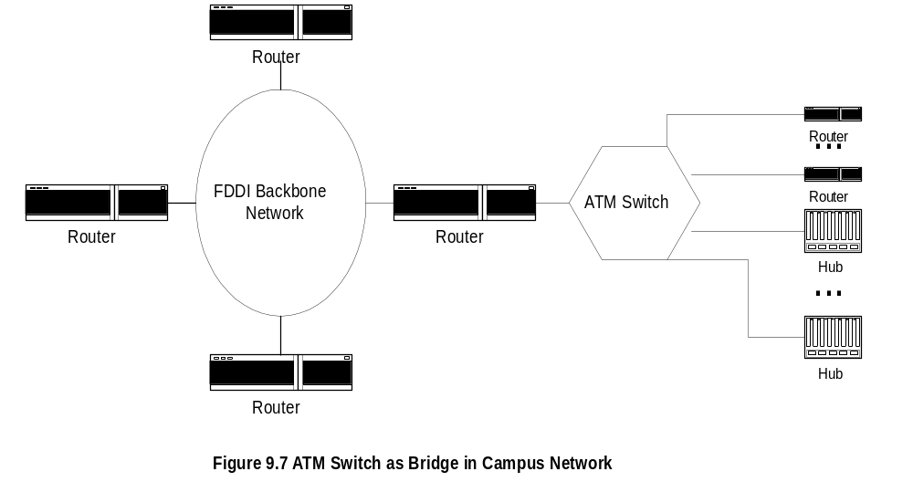
Chapter 9
ATM Campus Network
  Notes
Collapsed backbone design comprises backbone
built inside a router with ATM switch acting as
bridge to other nodes.
FDDI backbone shown above uses external
ATM switch as bridge between the router and
other nodes; LE services are built in the switch
Network Management: Principles and Practice
© Mani Subramanian 2000
9-11

Slide 12
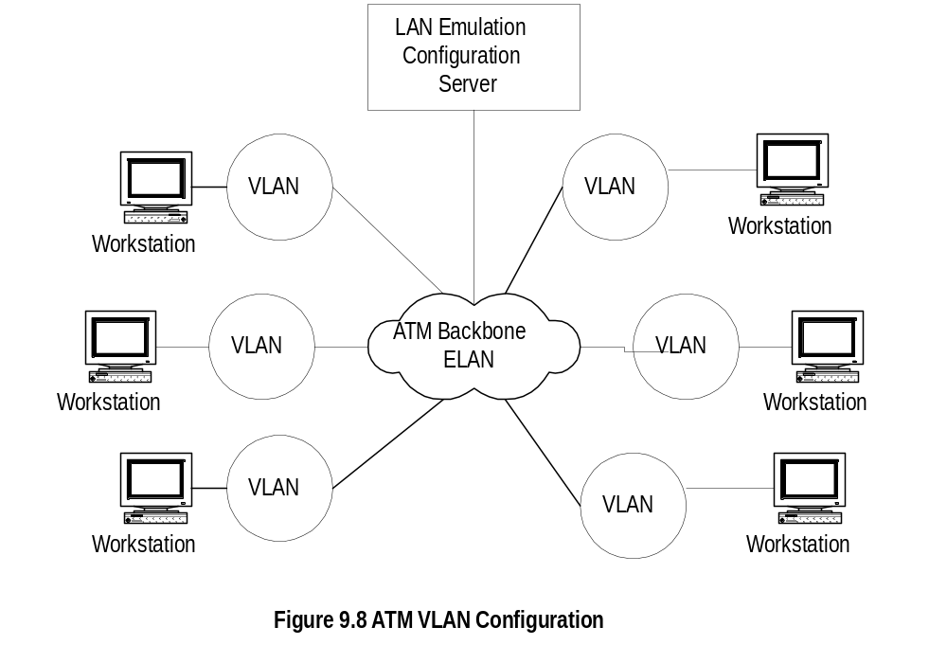
Chapter 9
ATM VLAN Configuration
  Notes
LECS configured to form VLAN groups
Each ATM switch has an interface to ATM ELAN
The ELAN backbone and all LANs on it are on
VLAN environment
Network Management: Principles and Practice
© Mani Subramanian 2000
9-12

Slide 13
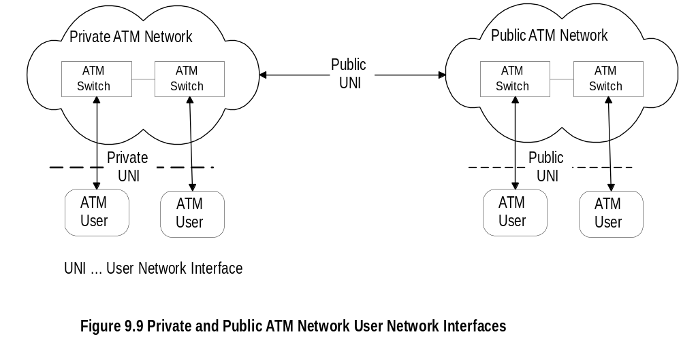
Chapter 9
ATM WAN Reference Model
  Notes
WAN service provided by public service providers
Private networks use public WAN facilities
Management functions (OAM&P)
  Operations
  Administration
  Maintenance
  Provisioning
Public and private User Network Interface (UNI)
define user interfaces
Network Management: Principles and Practice
© Mani Subramanian 2000
9-13

Slide 14
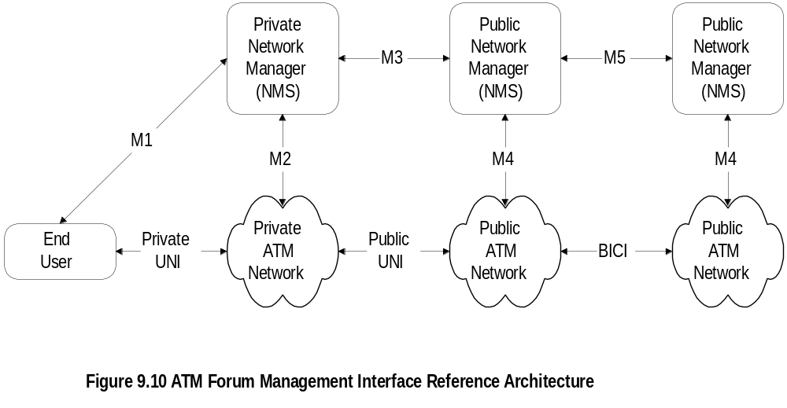
Chapter 9
ATM WAN Management
BICI Broadband inter-carrier interface
  Notes
Management interface architecture defined by
ATM Forum
Public and private NMS responsible to manage
respective domains
OSI has defined five management interfaces:
  M1 Interface between private NMS and end user
  M2 Interface between private NMS and network
  M3 Interface between private NMS and
  public NMS
  M4 Interface between public NMS and network
  M5 Interface between public NMSs
Network Management: Principles and Practice
© Mani Subramanian 2000
9-14

Slide 15
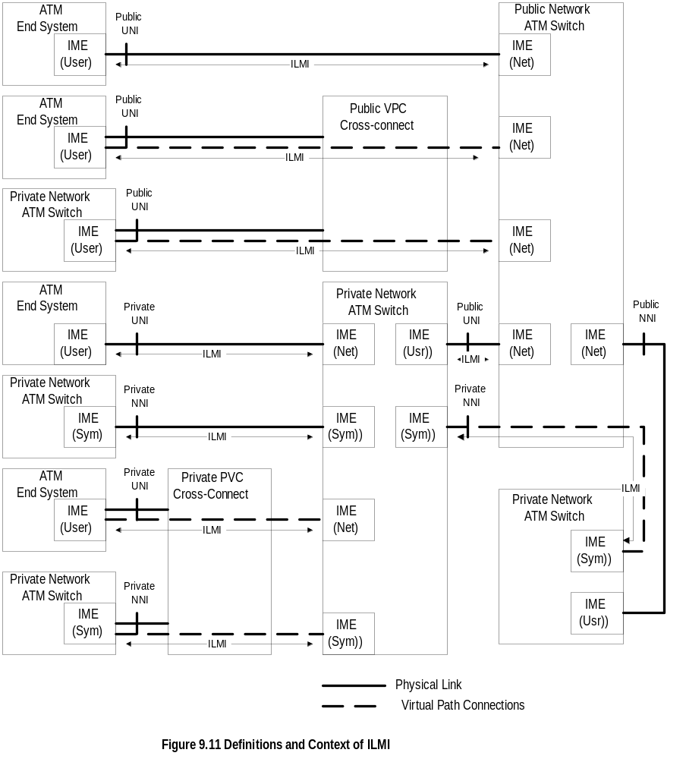
Chapter 9
Integrated Local Management Interface (ILMI)
  Notes
ATM Forum defines additional interface (ILMI)
  UNI User network interface
  NNI Network-Network interface
Network Management: Principles and Practice
© Mani Subramanian 2000
9-15

Slide 16
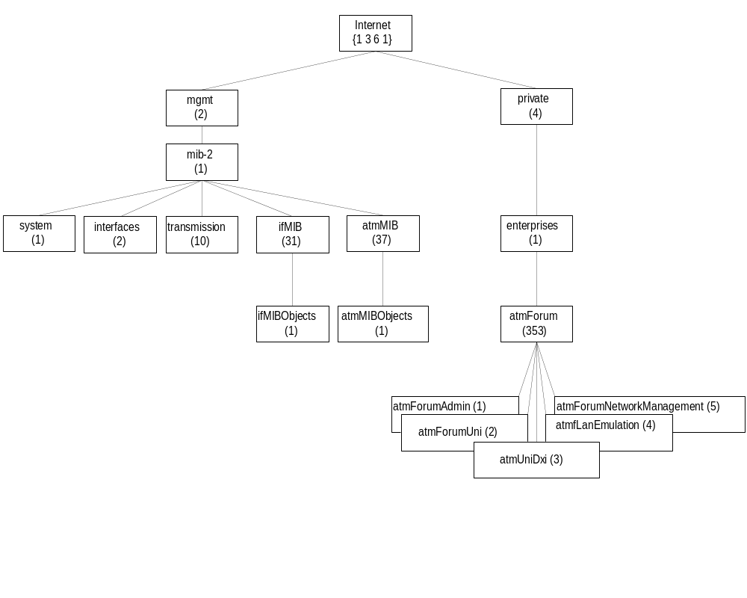
Chapter 9
ATM MIB
  Notes
MIBs defined in two sets of documents - IETF
(5 nodes) & ATM Forum (1 node)
ATM MIBs address ATM sublayer parameters only
ifMIB contains additional objects not covered in
interfaces MIB
atmMIB contains ATM objects
atmForum specifies interfaces, LANE, Mx, and ILMI
atmRMON (experimental) address ATM remote
monitoring (covered in Chapter 8)
Network Management: Principles and Practice
© Mani Subramanian 2000
9-16

Slide 17
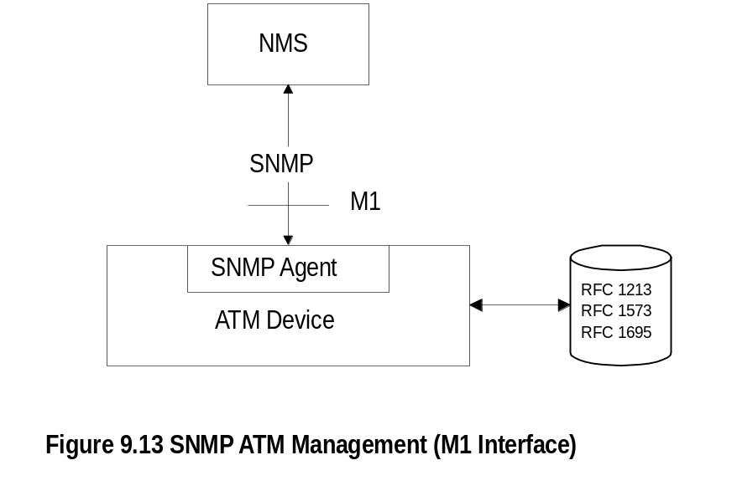
Chapter 9
SNMP ATM Management
  Notes
ATM Management specifications available for
both SNMP and OSI management implementations
SNMP agent built in ATM device
System, Interfaces, Interface types, transmission
carrier groups (T1, T3, SONET), and ATM object
groups are monitored
Network Management: Principles and Practice
© Mani Subramanian 2000
9-17

Slide 18
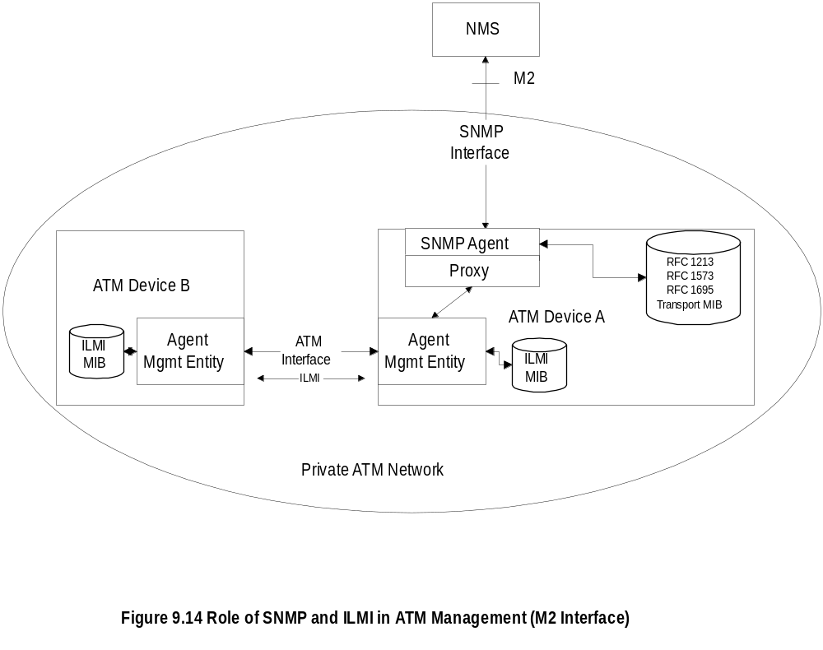
Chapter 9
SNMP and ILMI
  Notes
ILMI MIB used to gather data between ATM devices
Proxy agents convert ILMI objects to SNMP objects
Network Management: Principles and Practice
© Mani Subramanian 2000
9-18

Slide 19
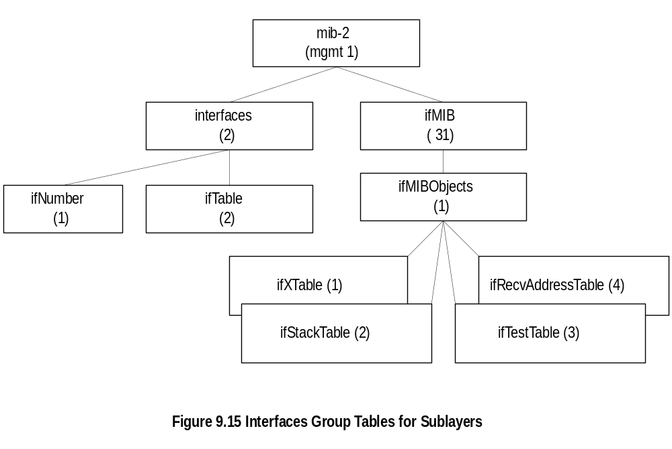
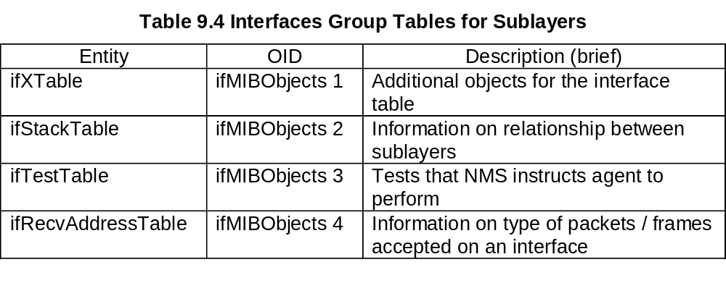
Chapter 9
M1 Interface Management
  Notes
M1 management interface is across an ATM device
Additional MIBs created using ifMIB group
to handle sublayers
Network Management: Principles and Practice
© Mani Subramanian 2000
9-19

Slide 20
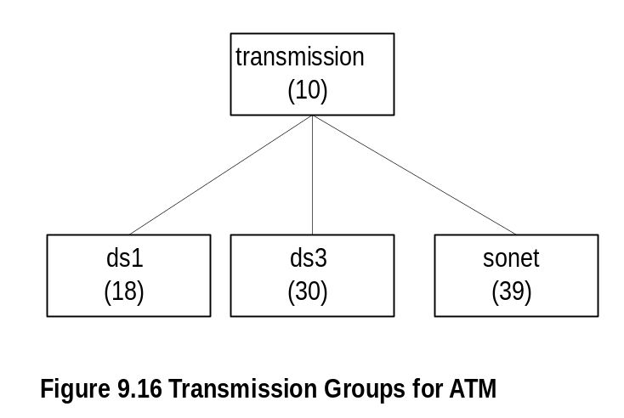
Chapter 9
ATM Transmission Groups
  Notes
Three transmission modes used for ATM in US
  DS1 1.544 Mbps T1 carrier
  DS3 44.736 Mbps T3 carrier
  SONET n X 155.52 Optical fiber
Network Management: Principles and Practice
© Mani Subramanian 2000
9-20

Slide 21
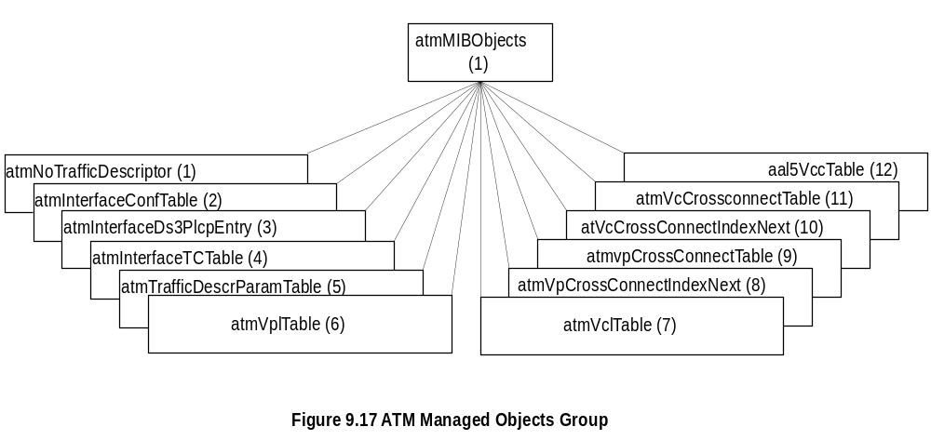
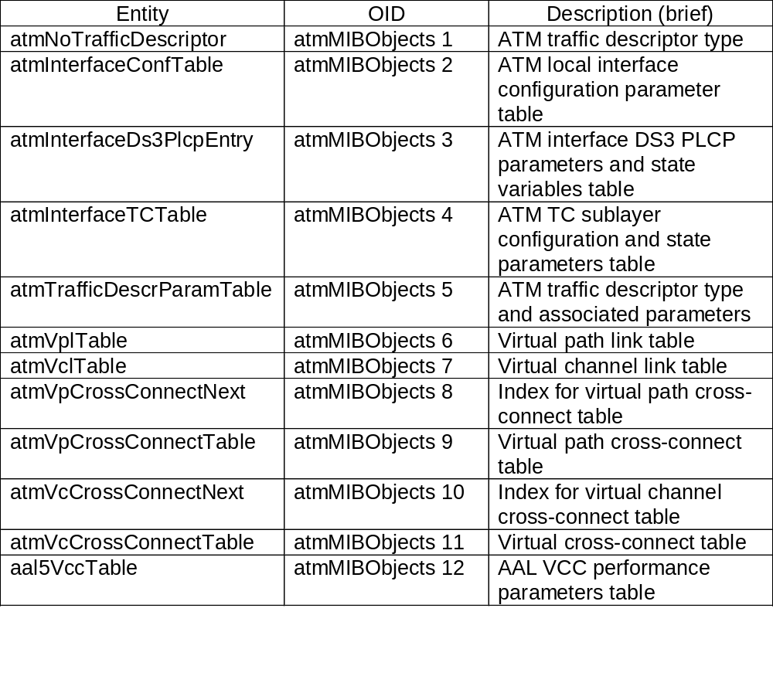
Chapter 9
ATM Managed Objects Group
Network Management: Principles and Practice
© Mani Subramanian 2000
9-21

Slide 22
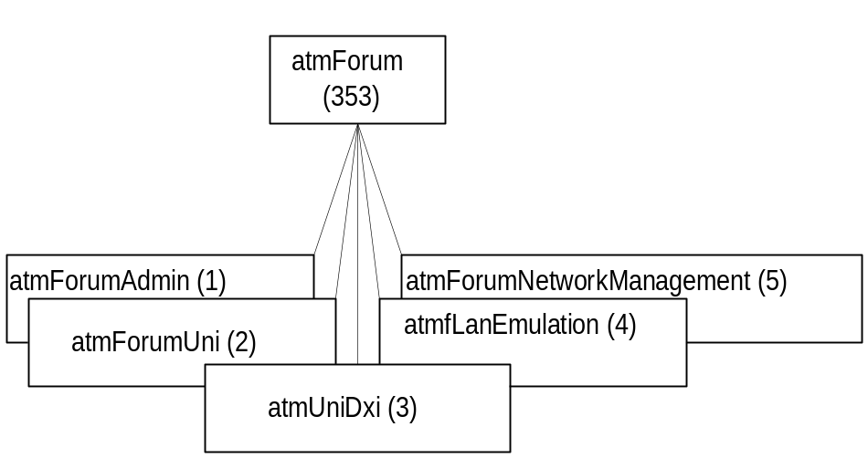
Chapter 9
M2 Interface Management
  Notes
M2 interface used to manage private networks
ATM link management data gathered using ILMI MIB
ILMI addresses:
  Administrative information (atmForumAdmin)
  - registry to locate ATM network services
  such as LECS and ANS
  UNI
  DXI (Data Exchange Interface)
  LAN Emulation
  NNI
Network Management: Principles and Practice
© Mani Subramanian 2000
9-22

Slide 23
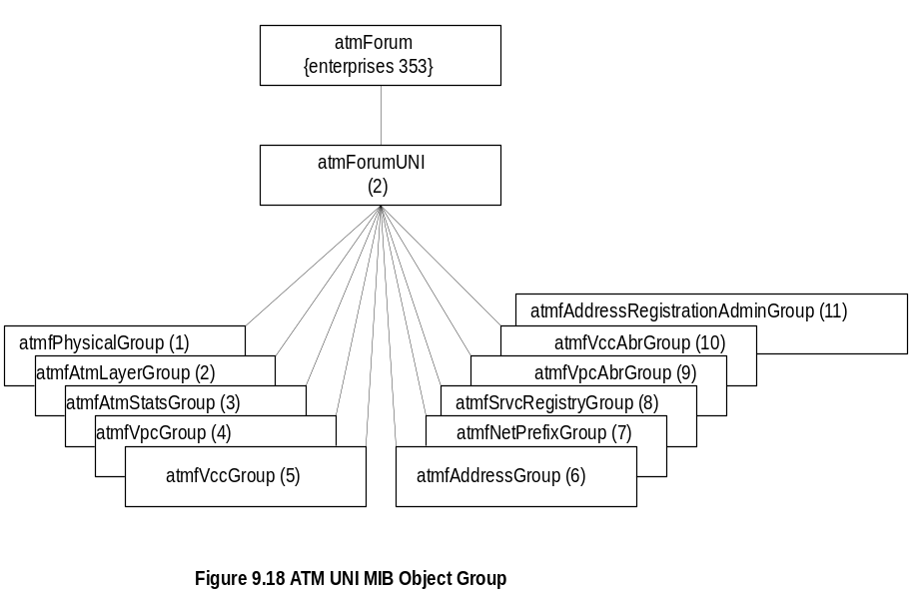
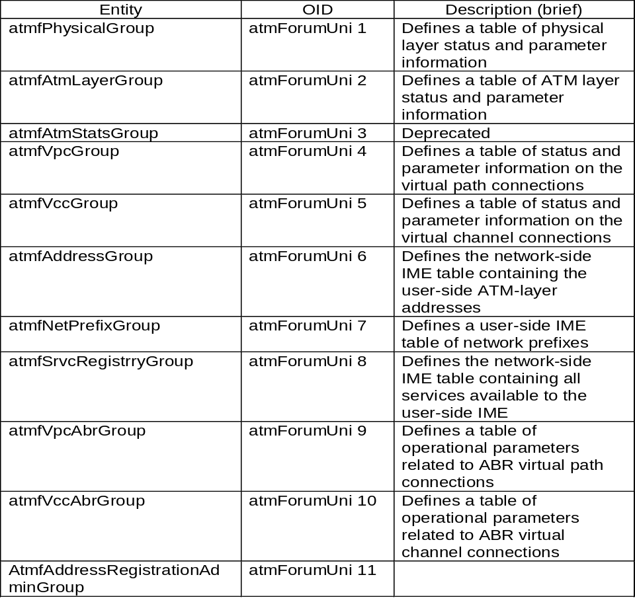
Chapter 9
ATM UNI Group
Network Management: Principles and Practice
© Mani Subramanian 2000
9-23

Slide 24
Chapter 9
M3 Interface
Services offered by public NMS to customer on PVCs
Two classes
  Class I: Status and configuration management
  Class II: Virtual configuration control
Class I:
  Functions offered by public NMS to customer -
  monitoring and management of configuration,
  fault, and performance
Class II:
  User ability to add, delete, and change VC
  between customer UNIs
Class I mandatory and Class II optional
  Notes
Class I examples
  Retrieving performance and configuration for
  UNI link
  Public NMS reporting of a UNI link failure
Class II examples
  Establishing a new VP
  Increase the number of VCs in a VP
Network Management: Principles and Practice
© Mani Subramanian 2000
9-24

Slide 25
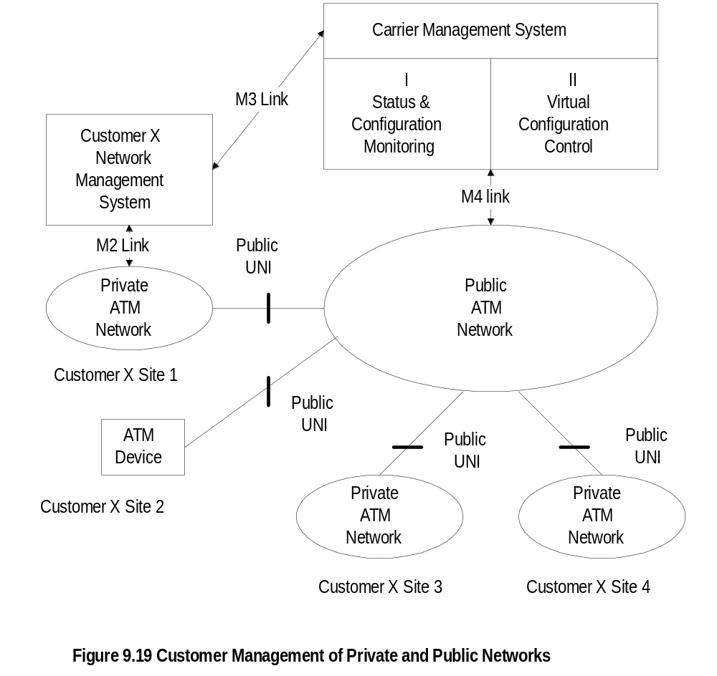
Chapter 9
Customer Network Management (CNM)
  Notes
CNM manages both private and public networks
CNM agent in public network provides M3 service
CNM manages its own ATM networks at sites
1, 3, and 4.
Network Management: Principles and Practice
© Mani Subramanian 2000
9-25

Slide 26
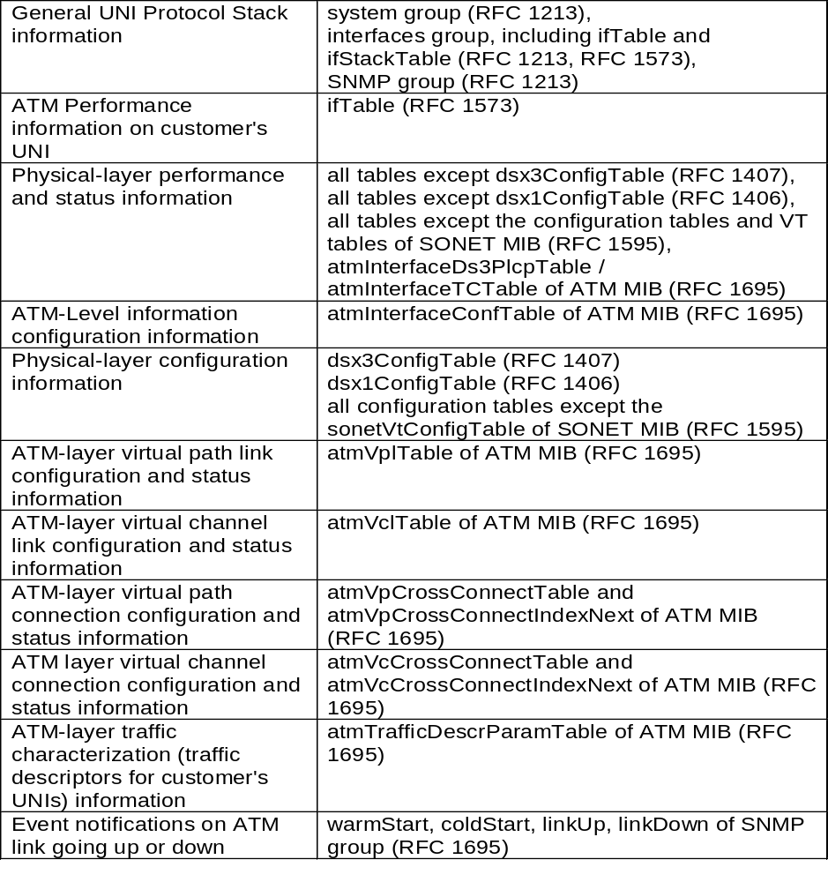
Chapter 9
M3 Class I Management
  Notes
Class I requirements used by customer NMS
from carrier NMS
The MIB access is “read-only”
Network Management: Principles and Practice
© Mani Subramanian 2000
9-26

Slide 27
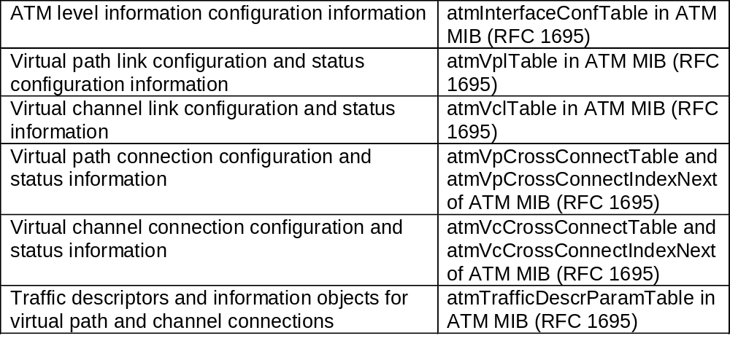
Chapter 9
M3 Class II Management
  Notes
Management information falls into three subgroups
  ATM-level subgroup: configuration modification
  VPC/VCC-level subgroup: configuration
  modification and status information of VP/VC
  link and connection
  Traffic subgroup: modification of traffic
  descriptors and information for VP/VC
  connections
Network Management: Principles and Practice
© Mani Subramanian 2000
9-27

Slide 28
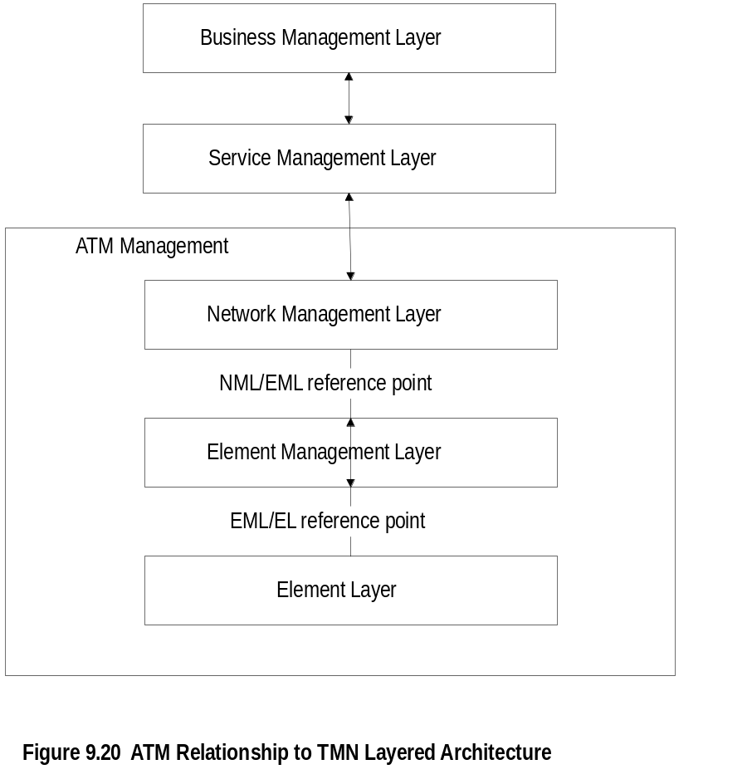
Chapter 9
ATM Relationship to TMN
  Notes
ITU-T definition of five-layer model to manage
telecommunications network
ATM heavily used in WAN, responsibility of public
service providers
The bottom three layers apply to ATM management
Reference points are abstract interfaces between
layers
Network Management: Principles and Practice
© Mani Subramanian 2000
9-28

Slide 29
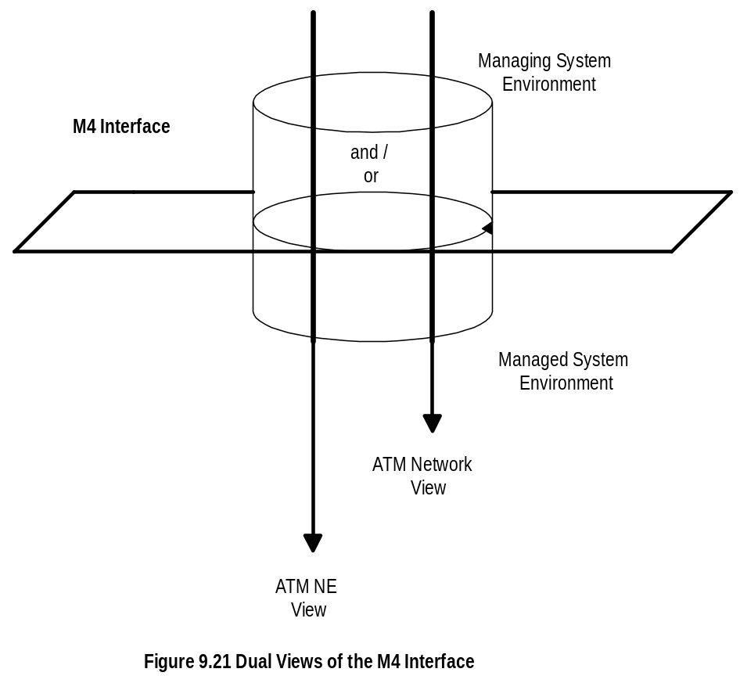
Chapter 9
M4 Interface
  Notes
M4 interface defines dual views
  Network element view
  Network view
Two NMSs interface at network view level
Each NMS interfaces with network elements using
network element view
Network Management: Principles and Practice
© Mani Subramanian 2000
9-29

Slide 30
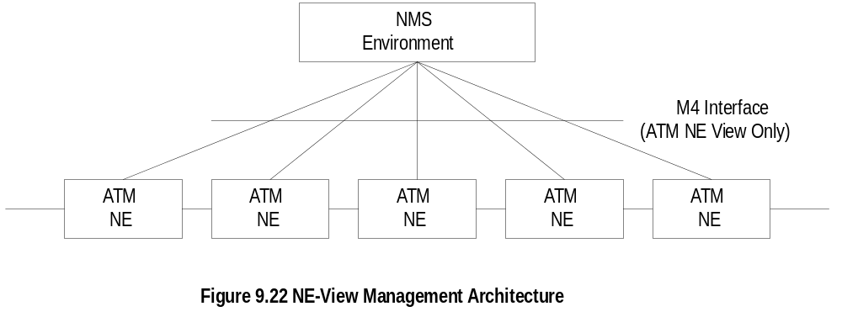
Chapter 9
Network Element View
  Notes
Network element view architecture proposed by
ATM Forum
Multiple agent layers - SNMP and ILMI agents
implied in the representation
Network Management: Principles and Practice
© Mani Subramanian 2000
9-30

Slide 31
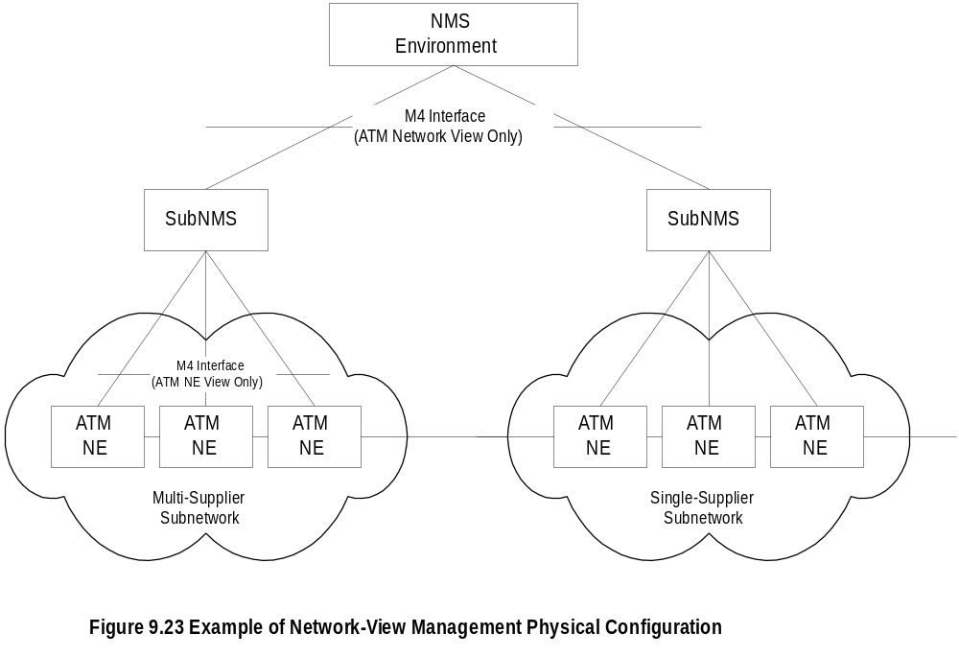
Chapter 9
Network View
  Notes
Three-tier architecture
Each subNMS manages its respective domains
SubNMS communicates with MoM at network view
level
Network Management: Principles and Practice
© Mani Subramanian 2000
9-31

Slide 32
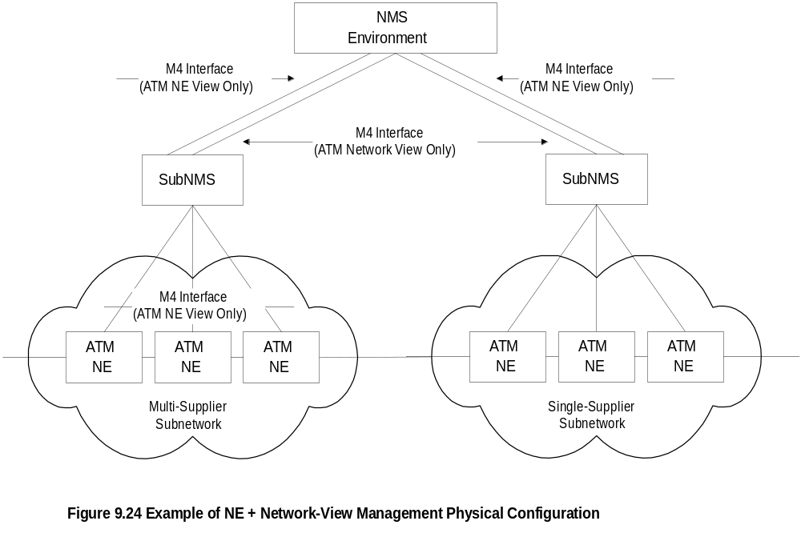
Chapter 9
Combined NE and Network Views
  Notes
An NMS could function at both levels simultaneously
Local elements can be managed using NE view and
remote elements using network view with subNMS
Network Management: Principles and Practice
© Mani Subramanian 2000
9-32

Slide 33
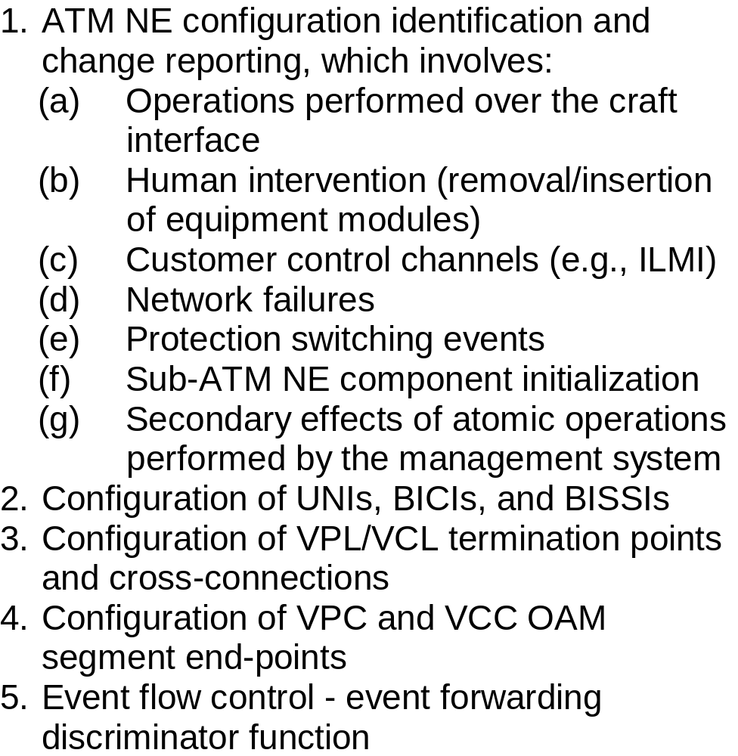
Chapter 9
M4 NE View Requirements:
Configuration Management
  Notes
Network Management: Principles and Practice
© Mani Subramanian 2000
9-33

Slide 34
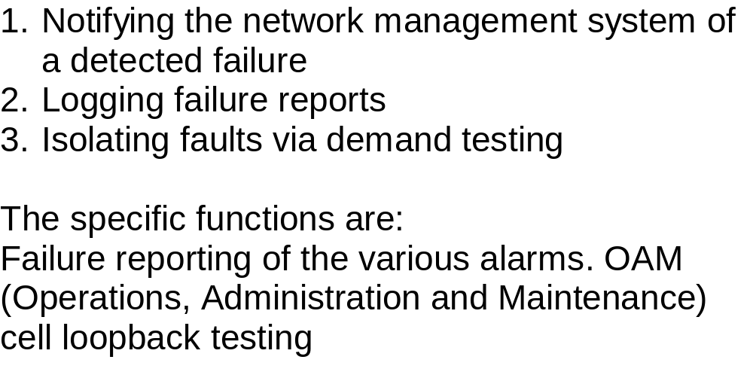
Chapter 9
M4 NE View Requirements:
Fault Management
  Notes
Network Management: Principles and Practice
© Mani Subramanian 2000
9-34

Slide 35
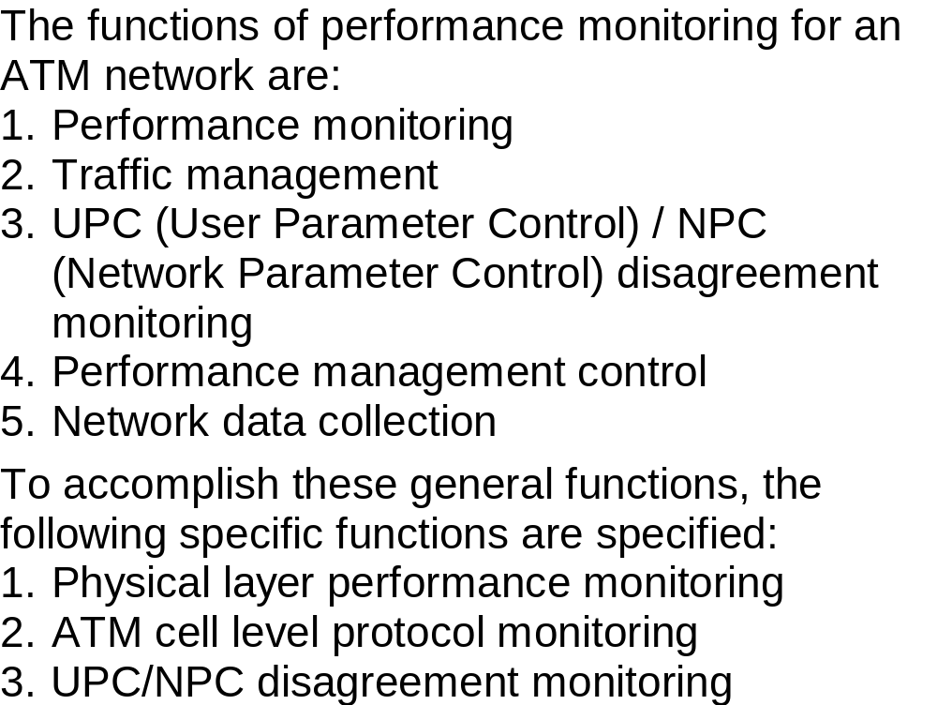
Chapter 9
M4 NE View Requirements:
Performance Management
  Notes
Network Management: Principles and Practice
© Mani Subramanian 2000
9-35

Slide 36
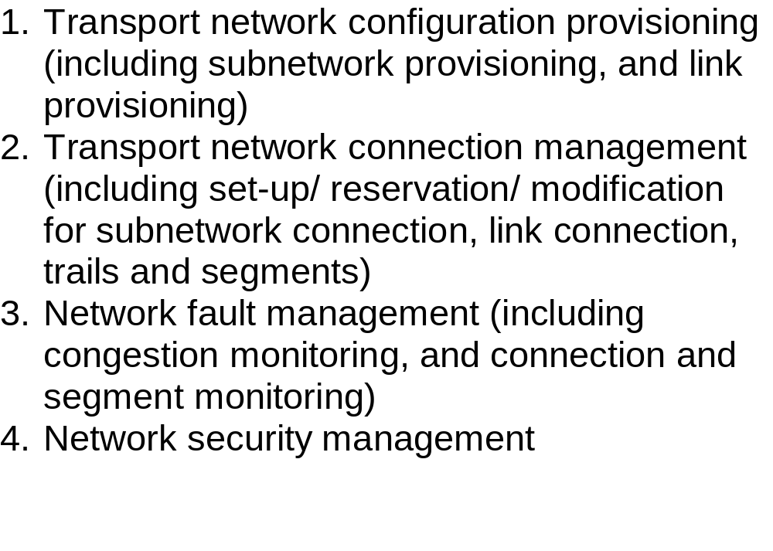
Chapter 9
M4 Network View Requirements
  Notes
Network Management: Principles and Practice
© Mani Subramanian 2000
9-36

Slide 37
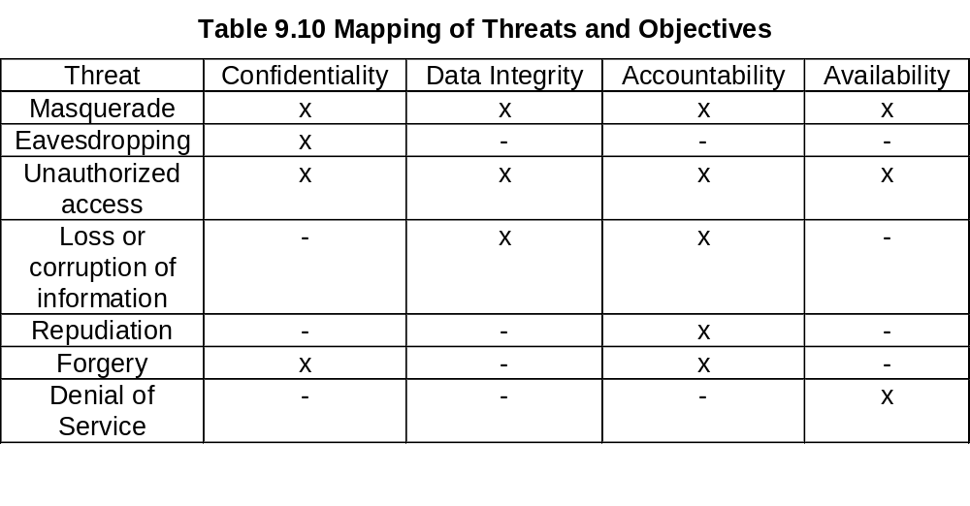
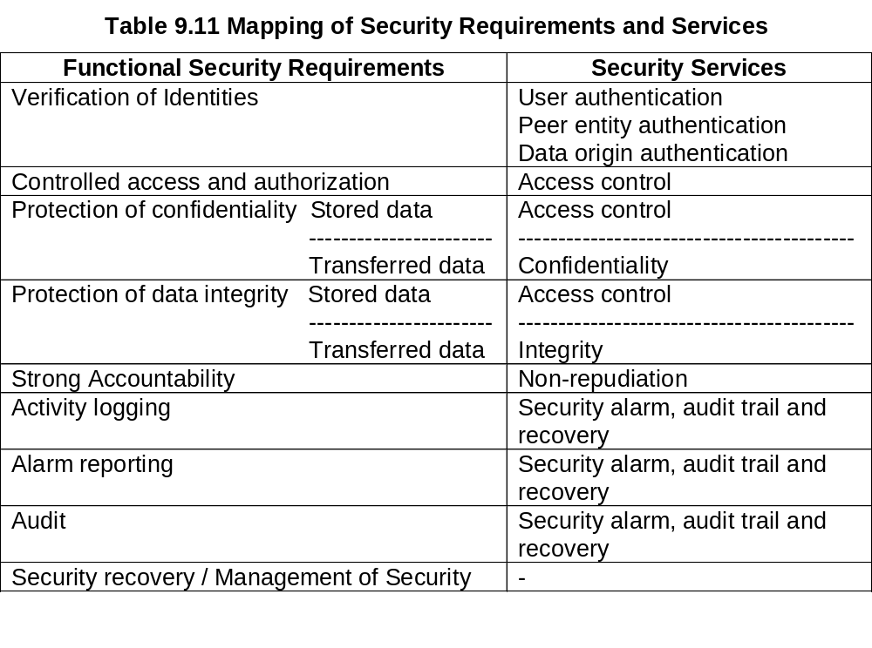
Chapter 9
M4 Network View Requirements:
Security Management
Network Management: Principles and Practice
© Mani Subramanian 2000
9-37

Slide 38
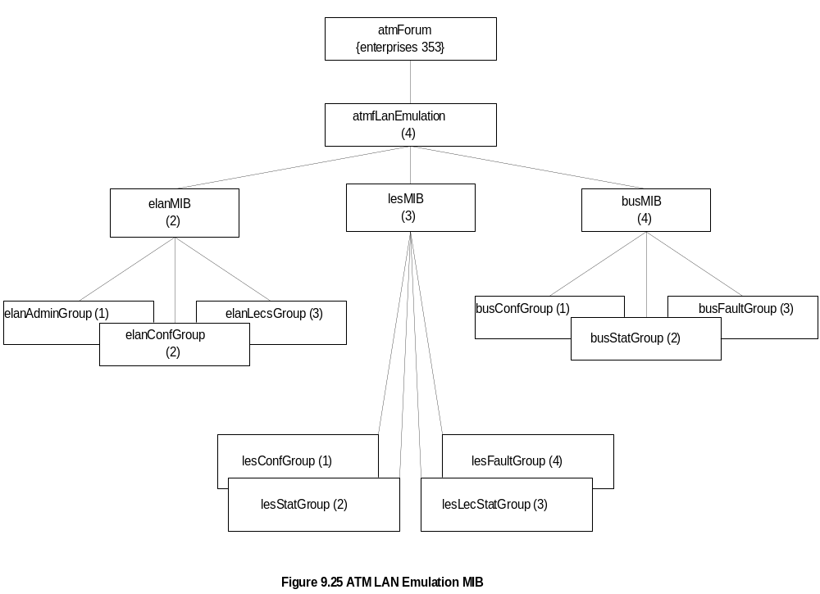
Chapter 9
Management of LANE
  Notes
ATM LAN managed by SNMP MIBs defined by IETF
LES, LECS, BUS, and LEC are managed by
ATM Forum MIB
ELAN MIB deals with information for a LEC to join
an ELAN
LES MIB used to create, configure, and monitor LESs
BUS MIB used to create, destroy, configure, and
determine BUS status; also ELAN topology
Network Management: Principles and Practice
© Mani Subramanian 2000
9-38

Slide 39
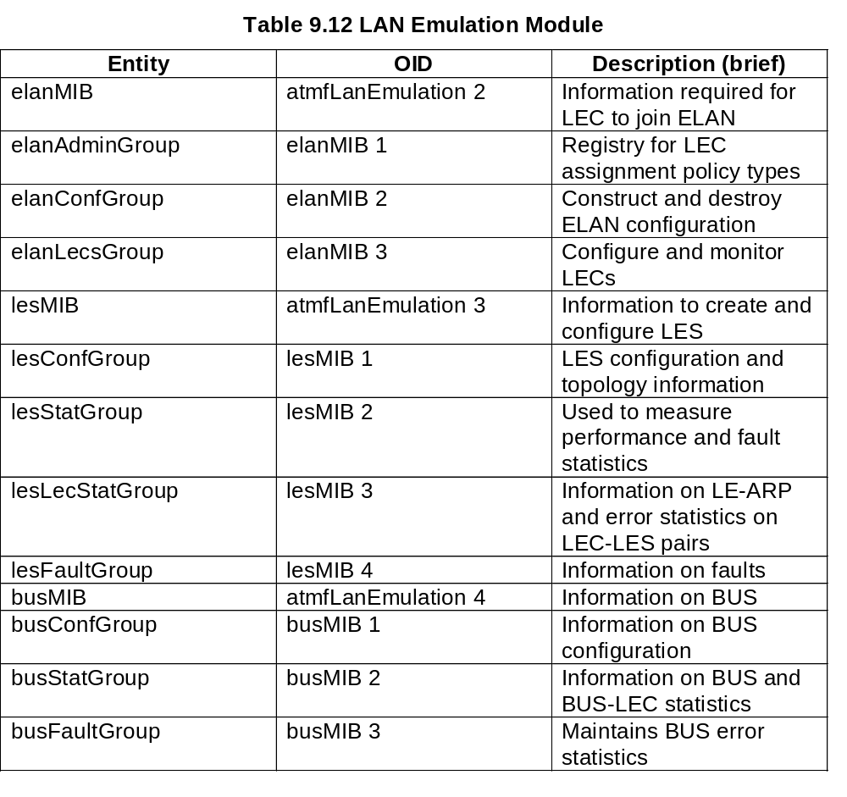
Chapter 9
LAN Emulation
  Notes
ELAN created by
  creating a new ELAN using elanMIB
  creating a LES entry for that ELAN using lesMIB
  creating a BUS entry for that ELAN using busMIB
Network Management: Principles and Practice
© Mani Subramanian 2000
9-39

Slide 40
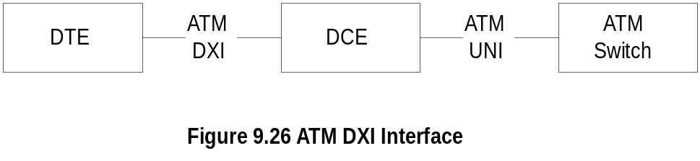
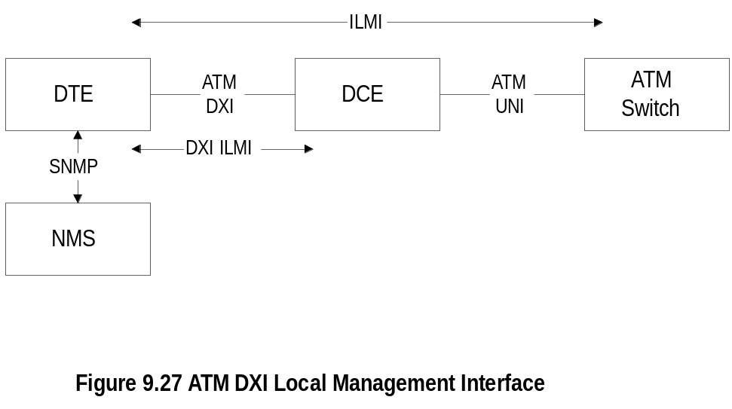
Chapter 9
ATM DXI Management
  Notes
Digital Exchange Interface defined between DTE
(digital terminating equipment) and DCE (digital
circuit equipment)
Example of DTE is hub and DCE is DSU (digital
service unit); ATM switch is part of public network
Management of DXI and ATM UNI done using ILMI
specifications
NMS manager uses SNMP with proxy agent for
ILMI management objects
Network Management: Principles and Practice
© Mani Subramanian 2000
9-40

